Slide 1
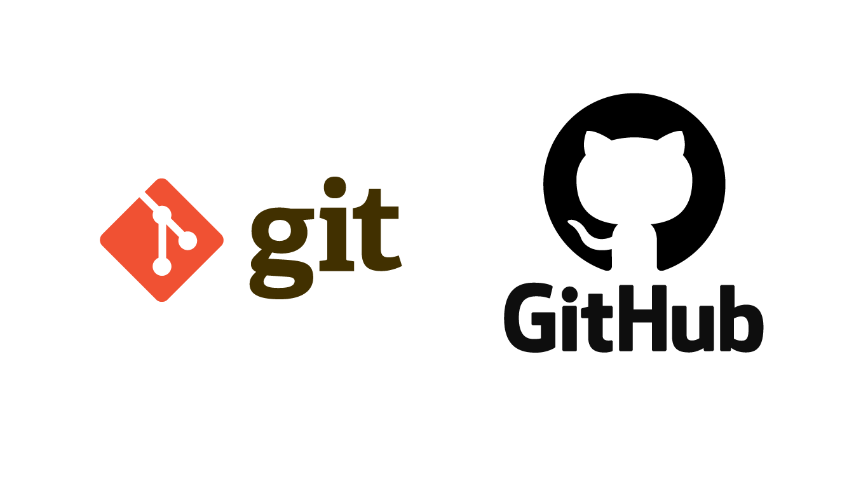
Git and GitHub Fundamentals
8BA103 – 2024
Alaa Bessadok, 18-11-2024
Notes:
Welcome to this course on Git and GitHub.
Git and GitHub are widely used in the industry for version control, and collaborative software development.

Slide 2


Meet your Lecturer
PhD in Computer Science (Tunisia)
Postdoc in MolecularML group (TU/e): deep learning for protein pocket representation learning

Slide 3
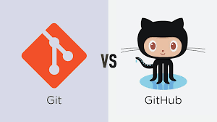

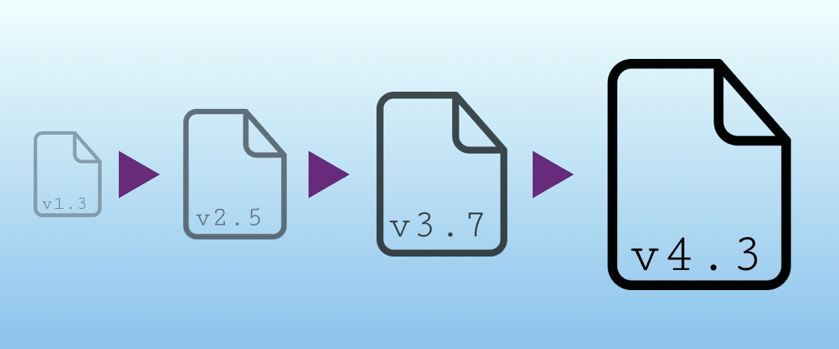
What will you learn?
Describe version control systems and differentiate between them
Explain Git and GitHub and their related terms
Managing GitHub project while working with a team

Slide 4
What is Version Control System (VCS)?
Version control is a system that records changes to a file or set of files over time so that you can recall specific versions later.

Slide 5

What is Version Control System (VCS)?
Local Version Control Systems
Many people’s version-control method of choice is to copy files into another directory
(+) Simple
(-) Error prone
Image credit: https://git-scm.com/book/ms/v2/Getting-Started-About-Version-Control
Notes:
Local VCSs involve copying files to a directory, but this method is prone to errors.
It is easy to forget which directory you’re in and accidentally write to the wrong file or copy over files you don’t mean to.

Slide 6
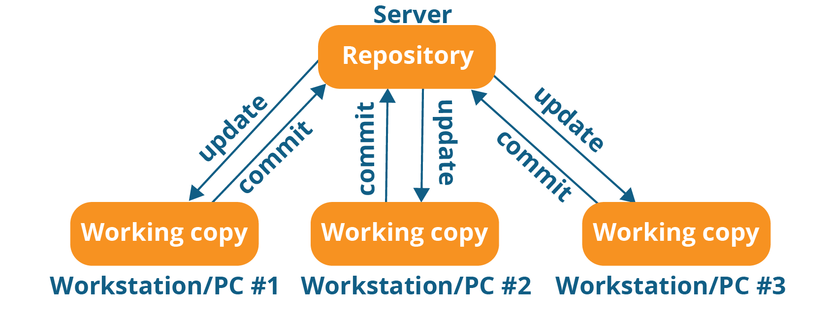
What is Version Control System (VCS)?
Centralized Version Control Systems
A single server that contains all the versioned files
(+) Everyone knows to a certain degree what everyone else on the project is doing
(-) Whenever you have the entire history of the project in a single place, you risk losing everything.
Image credits: https://www.edureka.co/blog/what-is-git/
Notes:
The next major issue that people encounter is that they need to collaborate with developers on other systems.
To deal with this problem, Centralized Version Control Systems (CVCSs) were developed.

Slide 7
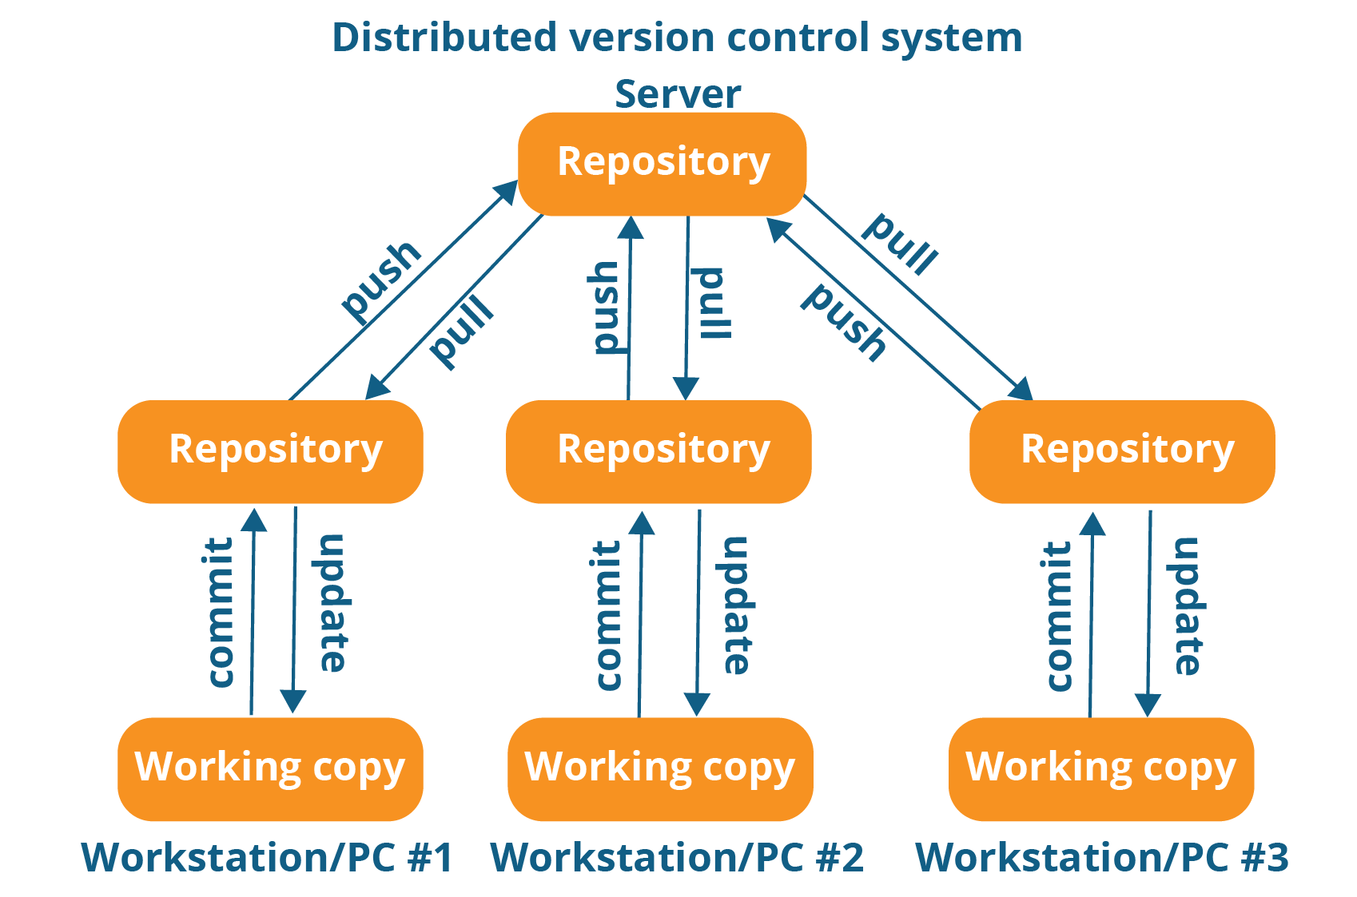
What is Version Control System (VCS)?
Distributed Version Control Systems
(+) Developers can access the full history of changes made to the repository.
Image credits: https://www.edureka.co/blog/what-is-git/
Notes:
clients don’t just check out the latest snapshot of the files; rather, they fully mirror the repository, including its full history.

Slide 8


What is Git?
Free and open source software
Created by Linus Torvads, April 2005
Distributed version control system
Accessible anywhere in the world
One of the most common version control systems available
Can also version control images, documents, etc.
Creator of Linux
Also, creator of Git
Notes:
(click) Git is free and open source software distributed under the new GNU General Public License.
(click) Created by Linus Torvads, April 2005
(click) Git is a distributed version control system, which means that users anywhere in the world can have a copy of your project on their own computer. When they have made changes, they can sync their version to a remote server to share it with you.
(click) Git is not the only version control system out there, but the distributed aspect is one of the main reasons it
(click) become one of the most common version control systems available.
(click) Version control systems are widely used for things involving code, but you can also version control images, documents, and any number of file types.

Slide 9




What is Git?
Notes:
You can use Git without a web interface by using your command line interface,
but GitHub is one of the most popular web-hosted services for Git repositories.
(click) Others include GitLab, BitBucket, and Beanstalk.

Slide 10
GitHub or GitLab?
Publicly hosted
Oriented towards code sharing and open-source community
Larger community
Privately hosted
More built-in features than GitHub for developers
Notes:
GitHub is an online hosting service for Git repositories.

Slide 11
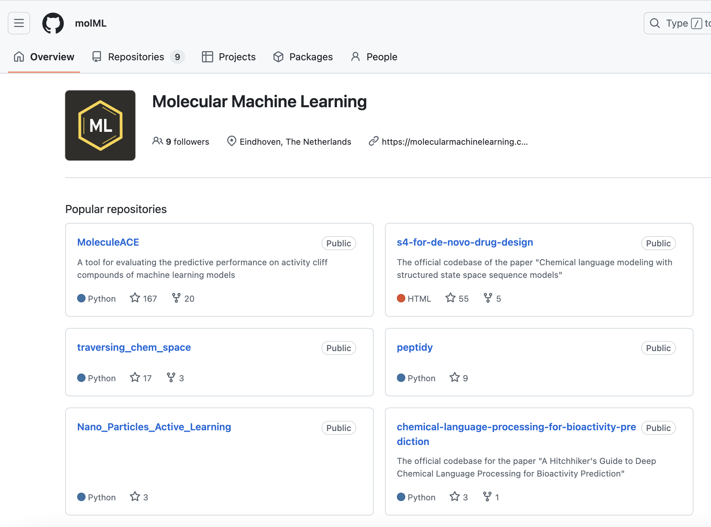
GitHub Repositories
What are Repositories?
A data structure for storing documents including application source code
It can track and maintain version control
Notes:
A repository is a data structure for storing documents including application source code. A repository can track and maintain version-control.

Slide 12
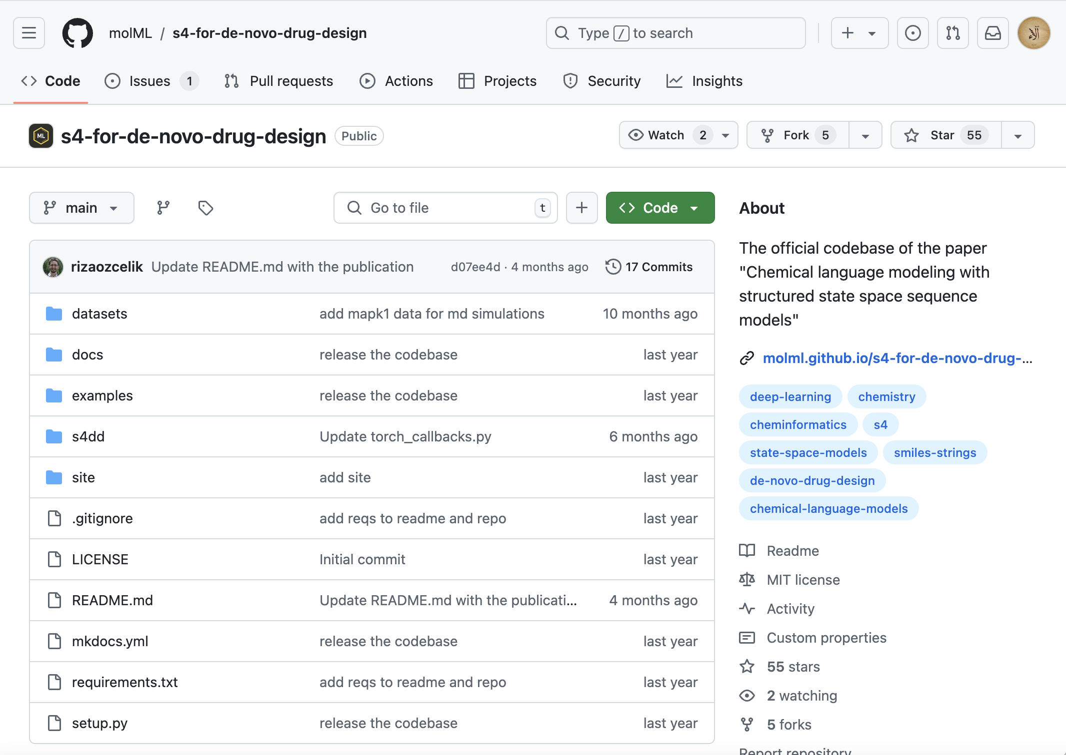
GitHub Repositories
What are Repositories?
A data structure for storing documents including application source code
It can track and maintain version control
Notes:
A repository is a data structure for storing documents including application source code. A repository can track and maintain version-control.

Slide 13
GitHub Branches
What are branches?
Branches store all files in GitHub
Master branch is the official version of the project
Child branch creates a copy of the master branch
Child Branch
branch
Master
Notes:
(click) All files in GitHub are stored on a branch.
(click) In Git and GitHub, there is a main branch called master. It has the deployable code and is the official working version of your project. It is meant to be stable, thus, it is advisable not to push any code that has not been tested in the master.
(click) If you want to change the code and the workflow in the master branch, you can create a copy of the master branch. This can be the child branch that will be a copy of the workflow. Now in the child branch, changes and experiments are done.

Slide 14
GitHub Branches
What are branches?
Edits and changes are made in the child branch
Tests are done to ensure quality before merging with the Master branch
build
test
Child Branch
branch
merge
Master
Notes:
(click) Now in the child branch, changes and experiments are done. (click) You can build, make edits, test the changes, and when you are satisfied with them, (click) you can merge them back to the master branch, where you can prepare the model for deployment.
(click) You can see that all of this is done outside the main branch and until you merge,
(click) changes will not be made to the workflow before you branched.

Slide 15
GitHub Branches
Merging branches
Branches allow for simultaneous development and testing by multiple team members
Child Branch A
branch
merge
Master
Child Branch B
Notes:
To ensure that changes done by one member, do not impede or affect the workflow of other members, multiple branches can be created and merged appropriately with the
master after the workflow is properly tested and approved.

Slide 16
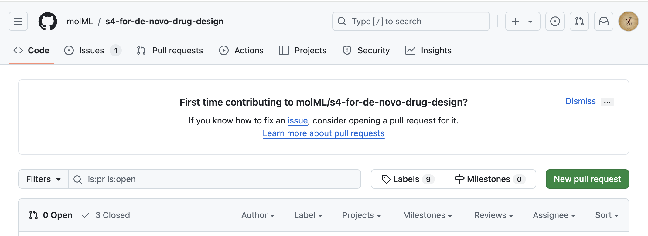
GitHub Branches
What is pull request?
Pull requests are a way of proposing changes to the main branch
Other team members review the changes and approve the merging to the master branch
Notes:
Ideally, another team member reviews the changes and approves them to be merged with the Master branch.
Pull requests are the means of collaboration on GitHub. When you open a pull request, you propose your changes. You can assign team members to review and approve your contribution and merge in the target branch.

Slide 17

GitHub Repositories
Original
upstream
Fork & Clone
Origin
1.Fork
Available only on the web interface
After cloning the repo:
Create branches
Add features
Fix bugs
Synchronization using push and merge is only possible for repos with write access
7.Pull Request
2.Clone
6.Push
Local repo
3.Branch
4. Add
5. Commit
Notes:
To fork a public project, you can go to its GitHub project page and select Fork at the top of the page. This fork option is available only while using the web interface. (click) The repo from which you create the fork is referred to as the original upstream repository. (click) Once you fork the original upstream, the forked copy of the repo becomes the origin, and developers with access to the origin can create clones of it on their local machines.
(click) After cloning, you can create branches and easily make changes to the code base, like adding features, enhancements, or fixing bugs. (click) Finally, you can add, commit, and push your changes to the branch and request to merge the branch with the main branch in the origin.
However, it is important to note that the synchronization of changes using push and merge can only be done with repos that the developers have right access to.

Slide 18
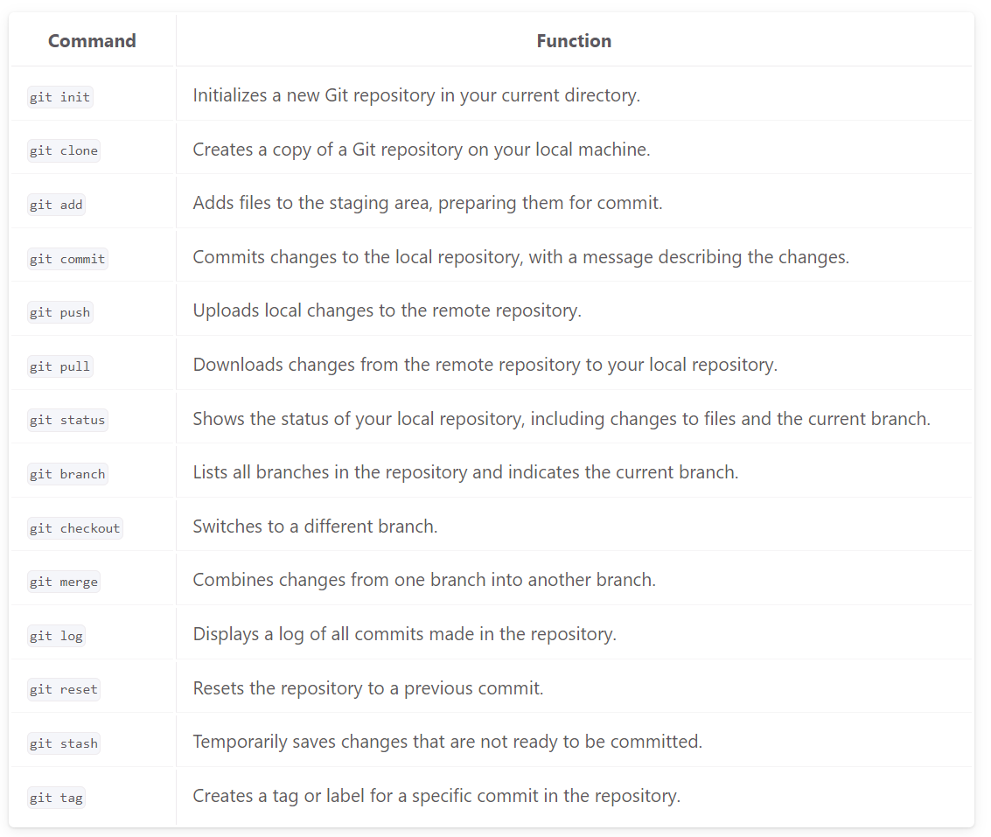
Useful Git Commands
https://molml.github.io/BME_data_analysis/doc_getting_started_03_version_control.html

Slide 19
Hands-on exercise (1)
Create a repository: public or private, readme file
Edit the readme file: commit changes
Create new file .py commit changes
Upload a file from local workspace, commit
Create a branch
Add file to the branch
Check the changes did not affect the master branch
Commit changes to a child branch
Open a pull request
Merge a pull request into the main branch

Slide 20
Hands-on exercise (2)
Fork existing repository
Clone forked repository
Create a new branch
Make changes locally
Add and commit to local branch
Merge the branch back into main branch and delete the branch
Push changes to your forked repository
Create a pull request to the upstream repository

Slide 21
Solution: Hands-on exercise (2)
Clone
In your list of repositories, click the forked repository. On the repository's main page, click the Code button.
Click the clipboard icon to copy the URL. Make sure the HTTPS tab is active
Open the terminal in the lab environment by using the menu in the editor: Terminal > New Terminal.
Let's export the copied URL in an environment variable so it's available for us to use in the later steps, run the following command in terminal:
export ORIGIN=<your repository HTTPS URL>
Replace <your repository HTTPS URL> with the URL you copied in step 2.
5. Run the following command with the HTTPS URL you copied earlier:
git clone $ORIGIN

Slide 22
Solution: Hands-on exercise (2)
Branch
Navigate to our repository using this command: cd TestRepo
Create a new branch using this command: git checkout -b coding_branch. Notice that we used a single command instead of creating a branch and then checking it out. The -b flag creates the branch if it does not already exist.
You can check that you are in the new branch by using the git branch command.

Slide 23
Solution: Hands-on exercise (2)
Make a change
Let's change one of the files.
If you do a git status at this point, you will see a change is shown. This change is not staged at this point, but Git is aware of it.
To move the changes from your working project directory to the staging area, type the following command in the Terminal window: git add .
To commit the new file to the local repository, you need to first tell git who you are. Type in the following commands to set your email and username. The email should be the same as your GitHub email.
Set your email: git config --global user.email email@example.com
Set your name: git config --global user.name "Your Name"

Slide 24
Solution: Hands-on exercise (2)
Commit
Type the following command in the Terminal window to commit the file. Note: It's always a good practice to add a description for the commit so you can remember what the change was if you have to refer to it later.
-m flag: It is used in Git commit commands to specify the commit message directly in the command line, allowing you to provide a brief description of the changes you are committing:
git commit -m "Changing two parameters in the python file”
As you can see, git status now says there is nothing to commit and the working tree is clean. The new file is now ready to be pushed from your local system to origin on GitHub.

Slide 25
Solution: Hands-on exercise (2)
Merge branches
git checkout main
git merge coding_branch
Confirm the change was merged by using the git log command.
To exit the git log command, simply press the "Q" key. This action will close the log view and bring you back to the command prompt.

Slide 26
Solution: Hands-on exercise (2)
Delete branch
Since you are done making the change, let's delete the feature-circle-500 branch by following these steps:
Ensure you are on the main branch. If not, check it out first
git checkout main
Delete the feature-circle-500 branch, the common flag used is -d (lowercase), which stands for "delete"
git branch -d coding_branch
You can confirm the branch was deleted by listing all branches
git branch

Slide 27
Solution: Hands-on exercise (2)
Push changes
To push your update to GitHub, complete the following steps:
In the Terminal window, run the following command: git push origin main
Go to the fork repository in your GitHub account and verify that the local changes have now been added to the main branch.

Slide 28
Solution: Hands-on exercise (2)
Pull Request
The final step is to request the original project pull in the changes you've made to your fork. To merge your changes to the original repository, you need to create a pull request. To create a pull request, complete the following steps:
Ensure you are on the Code tab. Click Contribute and then Open pull request.
In the "Comparing changes" panel, GitHub shows you that it is comparing the main branch of your fork to that of the original repository, and that your changes can be merged. Click the Create pull request button.
You are taken to the Open pull request screen. Notice that your commit message appears as the title of the pull request. Click the Create pull request button.

